Slide 1


CS7057 – Real Time Physics
Tiarnán McNulty - 13311241
Particle-Based Fluid Simulation for Interactive Applications
Matthias Müller, David Charypar, Markus Gross
(SIGGRAPH 2003)

Slide 2
Introduction
First Attempt
Initially looked at Jos Stam’s Stable Fluids paper.
Was difficult to know if it was working right without more complex rendering.
Decided to focus on particles, as debugging was more visual.
Second Attempt
Decided that Muller’s paper was easier to visualise.
Aimed to implement the core simulation logic.
Less concerned with attempts to realistically visualise surface particles.
Main Contributions
Presents Smoothed Particle Hydrodynamics (SPH) for fluids with free surfaces.
Provides special purpose smoothing kernels to allow for interactivity.
Uses Navier-Stokes to derive viscosity and pressure forces.

Slide 3
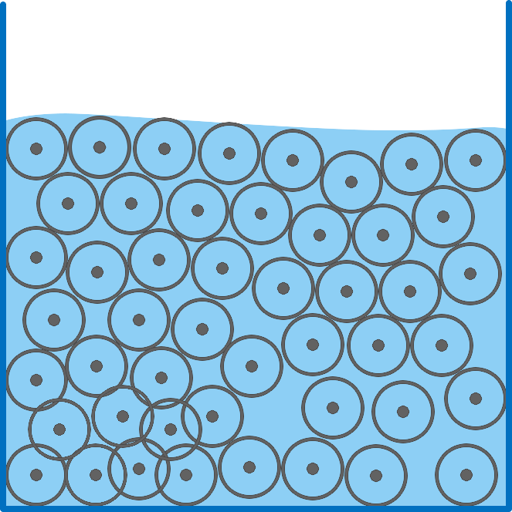
Lagrangian Fluid Dynamics
Particles are used to define a fluid.
Assumed the number of particles is constant.
Giving each particle a fixed mass ensures conservation.
Particles carry mass, position and velocity.
SPH provides us with smoothed approximations of the quantity of fluid “in” each particle.

Slide 4
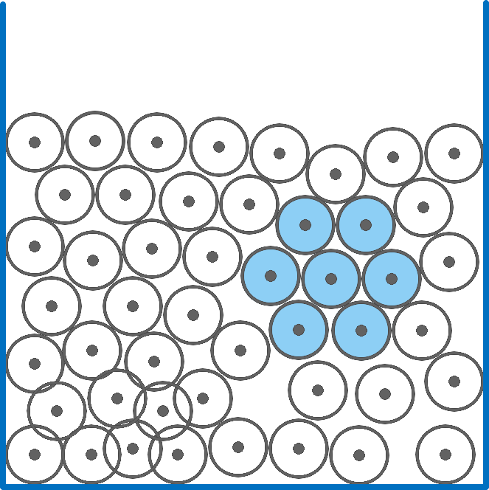
Ideal Fluid State
Particle density determines pressure. The pressure of neighbouring particles determines impact of internal forces.
A balanced amount of mass and density produces no pressure forces.
When all particles are balanced, the fluid is at rest.

Slide 5
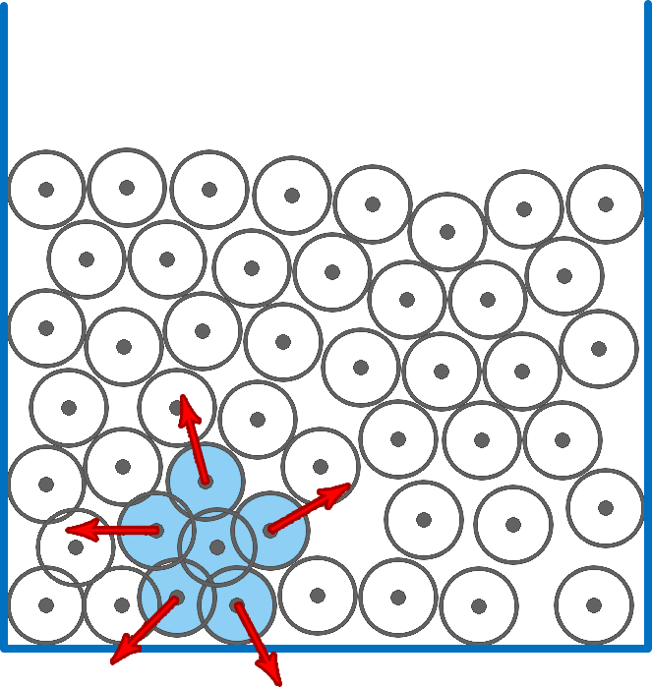
High Pressure State
A high mass / density produces repulsive pressure forces.
The fluid wants to spread out, and move into the less dense areas.

Slide 6
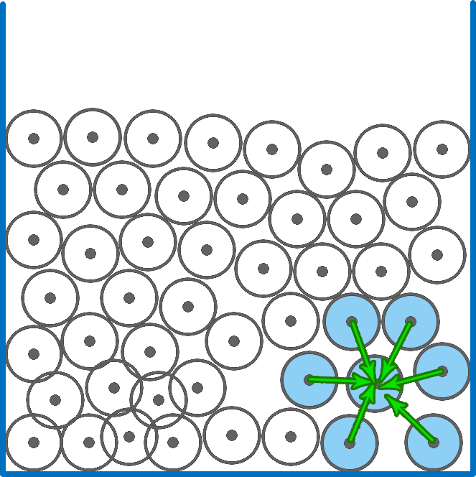
Low Pressure State
A low mass / density produces attractive viscosity forces.
Fluid wants to stay together.
Dense particles want to spread fluid to sparse areas.
Battle between pressure and viscosity constants to ensure a stable rest scenario.

Slide 7
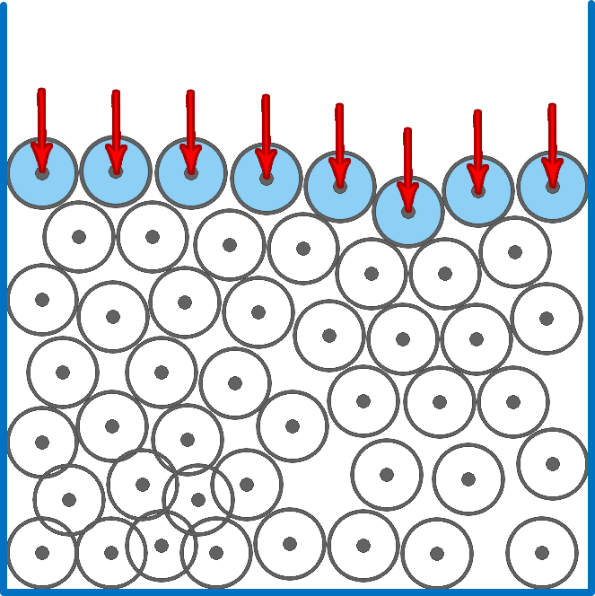
Surface Tension
Surface forces act to bind the surface particles together.
Main problem is trying to detect which particles are on the surface and which ones are inside the fluid.
Surface forces smooth out and calm down the edges of the fluid.

Slide 8
My Approach
Paper
Started by getting very confused by all the symbols in the paper.
Got slightly less confused by the symbols in other sources.
Created a quick translation chart between all the math symbols and their meaning.
Implemented brute-force approach which handled a few hundred particles.
Iterated on this until I got something that looked right.
Optimized the approach to scale up to thousands of particles.
Main stumbling block - Fine tuning the fluid constants!
Additional
Add container collisions to hold the fluid within an object.
Add interior collisions to have the fluid move around objects.
Tried to balance collision handling complexity against overall fluid performance.

Slide 9

My Approach
Paper
Started by getting very confused by all the symbols in the paper.
Got slightly less confused by the symbols in other sources.
Created a quick translation chart between all the math symbols and their meaning.
Implemented brute-force approach which handled a few hundred particles.
Iterated on this until I got something that looked right.
Optimized the approach to scale up to thousands of particles.
Main stumbling block - Fine tuning the fluid constants!
Additional
Add container collisions to hold the fluid within an object.
Add interior collisions to have the fluid move around objects.
Tried to balance collision handling complexity against overall fluid performance.

Slide 10

My Approach
Paper
Started by getting very confused by all the symbols in the paper.
Got slightly less confused by the symbols in other sources.
Created a quick translation chart between all the math symbols and their meaning.
Implemented brute-force approach which handled a few hundred particles.
Iterated on this until I got something that looked right.
Optimized the approach to scale up to thousands of particles.
Main stumbling block - Fine tuning the fluid constants!
Additional
Add container collisions to hold the fluid within an object.
Add interior collisions to have the fluid move around objects.
Tried to balance collision handling complexity against overall fluid performance.

Slide 11
Limitations
Expensive collisions
Spatial hashing allows for optimised searching of neighbour particles.
However collisions against world objects still happens per-particle.
So adding collisions has a noticeable impact on maximum particle count.
High Pressure = Low Framerate
When the container is moved, pressure builds up as forces push the fluid closer together.
This means each particle has many more neighbours for a few frames.
This greatly increases calculations for each particle, leading to framerate spikes.

Slide 12
Demonstration

Slide 13
Any Questions?
References / Links
Particle-based fluid simulation for interactive applications – SIGGRAPH 2003
http://dl.acm.org/citation.cfm?id=846298
Lagrangian Fluid Dynamics Using Smoothed Particle Hydrodynamics
http://image.diku.dk/projects/media/kelager.06.pdf
Smoothed Particle Hydrodynamics Real-Time Fluid Simulation Approach
https://www10.informatik.uni-erlangen.de/Publications/Theses/2010/Staubach_BA10.pdf

